Slide 1
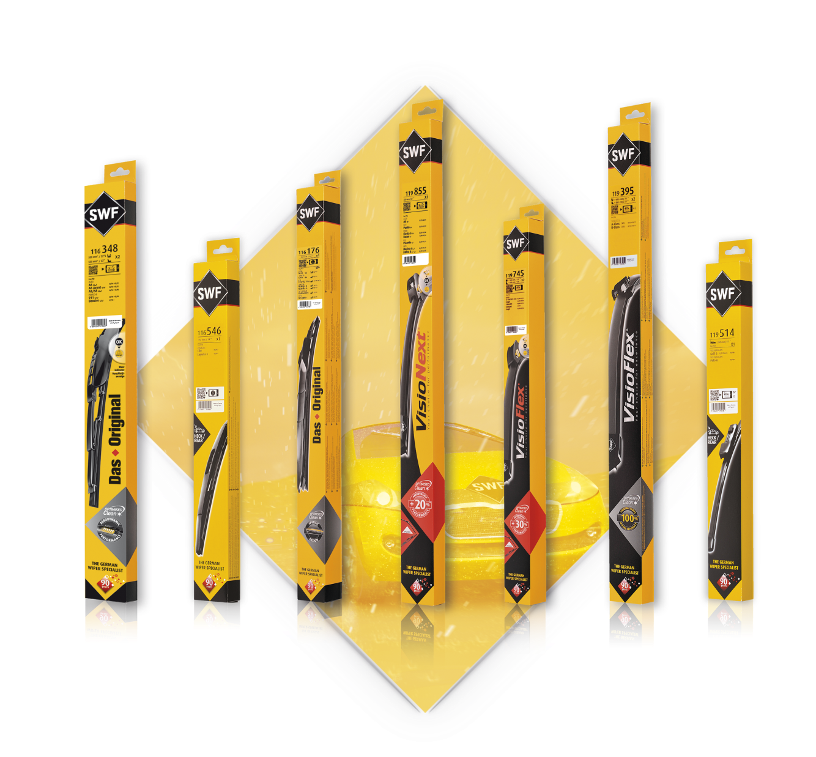
SAFE
DRIVING
PRESENTS
SWF WIPER BLADES
Providing the cleanest windscreen with SWF wipers allows you to drive safer

Slide 2
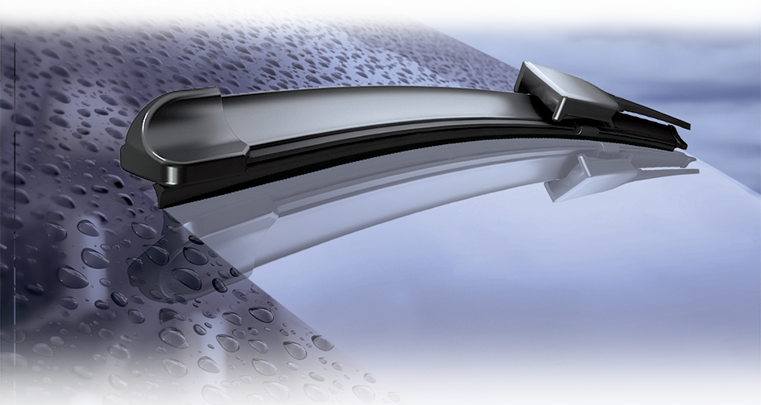
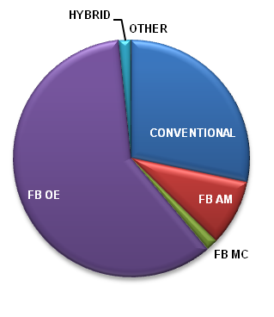
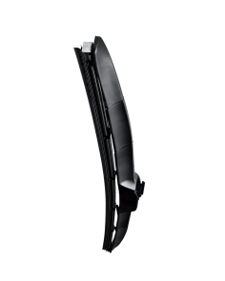
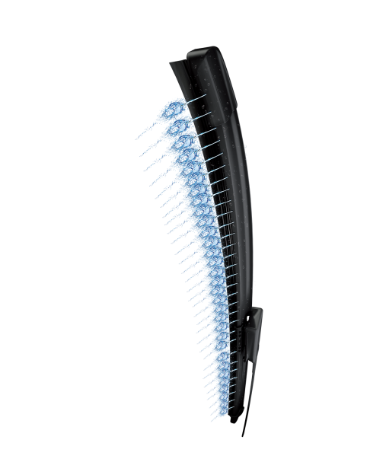
More than 98%
coverage of European parc
WIPER BLADES
Exact O.E. Fit
361 P/N
already available
+17 P/N
by end of Q1 2019
Valeo is the only supplier offering
all Wiper O.E. Technologies including:
Exclusive Front and Rear Multi-connection
Share of SWF sales per wipers technologies
HYBRID
Notes:
Why is Valeo a legitimate player for the aftermarket solution in this range?
Legitimacy via technology or beacause leader or because OE adquisitions
Market share OE or growth OE
Innovation OE/IAM
Quality references (awards)
Integration in Valeo Group strategy (smart, green solutions...)
Product regognition IAM or OE

Slide 3
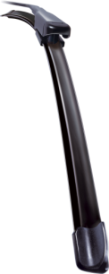
WIPER BLADES OFFER
LEGITIMATE POSITIONING
The offer of the n°1 Wipers System original equipment manufacturer

Slide 4
RECOGNIZED WIPERS EXPERT
Since 1922
WIPER BLADES
More than
130 Million
wiper blades produced by Valeo every year
EXCLUSIVITY
1 out of 2 vehicles are equipped with Valeo wiper blades
Notes:
Why is Valeo a legitimate player for the aftermarket solution in this range?
Legitimacy via technology or beacause leader or because OE adquisitions
Market share OE or growth OE
Innovation OE/IAM
Quality references (awards)
Integration in Valeo Group strategy (smart, green solutions...)
Product regognition IAM or OE

Slide 5
WIPER BLADES OFFER
WHY CHOOSE VALEO?
Make your workshop life easier with SWF WIPER BLADES

Slide 6
Quality, Performance
& Innovation
of the German wipers
WIPER BLADES
SWF category management means business development!
99%
of the range is Made in EUROPE
Guarantee of a silent wiping
Specific rubber with exclusive coating on the lip
Natural rubber
Protective coating
Notes:
Why is Valeo a legitimate player for the aftermarket solution in this range?
Legitimacy via technology or beacause leader or because OE adquisitions
Market share OE or growth OE
Innovation OE/IAM
Quality references (awards)
Integration in Valeo Group strategy (smart, green solutions...)
Product regognition IAM or OE

Slide 7
WIPER BLADES OFFER
GROWTH OPPORTUNITIES
Develop your business in the most simple way: with Valeo Service

Slide 8
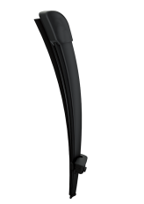
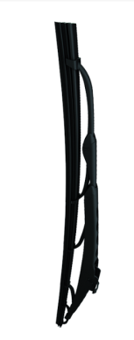
THE ESSENTIALS
CHOOSE THE RIGHT CARDS
THE ESSENTIALS
CHOOSE THE RIGHT CARDS
FLAT BLADES
SWF Ref | Length (mm) | Range
116500 | 260 | SWF - Das Original
116518 | 400 | SWF - Das Original
116555 | 400 | SWF - Das Original
116601 | 400 | SWF - Das Original
116602 | 450 | SWF - Das Original
116604 | 500 | SWF - Das Original
116606 | 550 | SWF - Das Original
116607 | 530 | SWF - Das Original
116612 | 600 | SWF - Das Original
116615 | 600 | SWF - Das Original
SWF Ref | Length (mm) | Range
119305 | 600+475 | SWF - VisioFlex® - VW GOLF V SKODA YETI
119260 | 600+380 | SWF - VisioFlex® - AUDI A1 (09/10)
119407 | 650+600 | SWF - VisioFlex® - MB SPRINTER
119272 | 650+450 | SWF - VisioFlex® - AUDI A3 VW GOLF VII
119298 | 600+450 | SWF - VisioFlex® - VW TOURAN PEUGEOT 308
119355 | 600+475 | SWF - VisioFlex® - AUDI A3 VW GOLF V JETTA
119385 | 650+400 | SWF - VisioFlex® - OPEL CORSA D CORSA E
119378 | 600+400 | SWF - VisioFlex® - RENAULT TWINGO II
119297 | 600+500 | SWF - VisioFlex® - AUDI A4 A5 Q3 Q5
119416 | 650+550 | SWF - VisioFlex® - PSA JUMPER BOXER
119284 | 600+475 | SWF - VisioFlex® - BMW 3-SERIES (E90/91)
119261 | 600+475 | SWF - VisioFlex® - AUDI Q2 VW PASSAT
119394 | 650+425 | SWF - VisioFlex® - FORD FOCUS
119303 | 530+530 | SWF - VisioFlex® - SKODA FABIA ROOMSTER
119383 | 700+700 | SWF - VisioFlex® - GALAXY / ALHAMBRA / SHARAN
119381 | 650+650 | SWF - VisioFlex® - MERCEDES CLASS E
119395 | 650+580 | SWF - VisioFlex® - MERCEDES A-CLASS 650/580
119412 | 650+380 | SWF - VisioFlex® - FIAT GRANDE PUNTO
119319 | 530+475 | SWF - VisioFlex® - GOLF IV ET POLO IV
119301 | 530+475 | SWF - VisioFlex® - VW POLO SEAT CORDOBA
CONVENTIONAL
X1
SWF Ref | Length (mm) | Range
116351 | 530+475 | SWF - Das Original
116222 | 530+530 | SWF - Das Original
116342 | 550+550 | SWF - Das Original
116341 | 600+600 | SWF - Das Original
116340 | 600+525 | SWF - Das Original
116339 | 550+500 | SWF - Das Original
116366 | 530+530 | SWF - Das Original
116218 | 475+475 | SWF - Das Original
116348 | 550+550 | SWF - Das Original
116346 | 600+450 | SWF - Das Original
CONVENTIONAL
X2

Slide 9
THE ESSENTIALS
CHOOSE THE RIGHT CARDS
THE ESSENTIALS
CHOOSE THE RIGHT CARDS
REAR
NEW TO RANGE
SWF Ref | Length (mm) | Range
116520 | 300 | SWF - Das Original
119514 | 280 | SWF - VisioFlex®
116550 | 400 | SWF - Das Original
119504 | 335 | SWF - VisioFlex®
116540 | 350 | SWF - Das Original
116530 | 290 | SWF - Das Original
119518 | 335 | SWF - VisioFlex®
119502 | 405 | SWF - VisioFlex®
116515 | 300 | SWF - Das Original
116513 | 300 | SWF - Das Original
SWF Ref | Length (mm) | Range
119481 | 550 + 400 | SWF - VisioFlex® - DACIA DOKKER LODGY
119482 | 600 + 450 | SWF - VisioFlex® - DACIA DUSTER I
119478 | 600 + 500 | SWF - VisioFlex® - LAND ROVER DISCOVERY
119478 | 600 + 500 | SWF - VisioFlex® - LAND ROVER RANGE ROVER
119479 | 650 + 400 | SWF - VisioFlex® - LEXUS NX300H
119484 | 580 + 530 | SWF - VisioFlex® - MINI COUNTRYMAN
119477 | 680 + 425 | SWF - VisioFlex® - PEUGEOT 3008 II
119477 | 680 + 425 | SWF - VisioFlex® - PEUGEOT 5008 II
119483 | 650 + 380 | SWF - VisioFlex® - RENAULT CAPTUR
119479 | 650 + 400 | SWF - VisioFlex® - TOYOTA C-HR
119480 | 700 + 400 | SWF - VisioFlex® - TOYOTA PRIUS
119487 | 655 + 505 | SWF - VisioFlex® - BMW X3 X4
119488 | 700 + 345 | SWF - VisioFlex® - FIESTA VII
119485 | 580 + 350 | SWF - VisioFlex® - NISSAN JUKE
119104 | 580 + 450 | SWF - VisioFlex® - AQUABLADE RENAULT ALPINE
119486 | 625 + 530 | SWF - VisioFlex® - SKODA KODIAQ
119489 | 705 + 655 | SWF - VisioFlex® - VW CRAFTER
119102 | 650 + 480 | SWF - VisioFlex® - AQUABLADE XC60 NO HEATING
119108 | 650 + 480 | SWF - VisioFlex® -AQUABLADE XC60 HEATING OPTION
119110 | 600 + 500 | SWF - VisioFlex® - AQUABLADE V60 NO HEATING OPTION
119112 | 600 + 500 | SWF - VisioFlex® - AQUABLADE V60 HEATING OPTION
HYBRID
SWF Ref | Length (mm) | Range
116183 | 600 | SWF - Das Original / HBlade®
116185 | 650 | SWF - Das Original / HBlade®
116176 | 450 | SWF - Das Original / HBlade®
116174 | 400 | SWF - Das Original / HBlade®
116187 | 700 | SWF - Das Original / HBlade®
116172 | 350 | SWF - Das Original / HBlade®
116179 | 525 | SWF - Das Original / HBlade®
116178 | 500 | SWF - Das Original / HBlade®
116180 | 550 | SWF - Das Original / HBlade®
116177 | 480 | SWF - Das Original / HBlade®

Slide 10
FRONT ESSENTIALS
CHOOSE THE RIGHT CARDS
REAR ESSENTIALS
CHOOSE THE RIGHT CARDS
SWF Ref | Short Code | Length (mm) | Cross List
262200 | SC35 | 350 | 3397006827 / AP13U
262201 | SC38 | 380 | 3397006828 / AP15U
262202 | SC40 | 400 | 3397006829 / AP16U
262203 | SC43 | 430 | 3397006830 / AP17U
262204 | SC45 | 450 | 3397006831 / AP18U
262205 | SC48 | 480 | 3397006832 / AP19U
262206 | SC50 | 500 | 3397006833 / AP20U
262207 | SC53 | 530 | 3397006834 / AP21U
262208 | SC55 | 550 | 3397006835 / AP22U
262209 | SC55B | 550 | 3397006835 / AP22U
262210 | SC58 | 580 | 3397006836 / APU23
262211 | SC60 | 600 | 3397006837 / APU24
262212 | SC60B | 600 | 3397006837 / APU24
262213 | SC65 | 650 | 3397006838 / APU26
262214 | SC65B | 650 | 3397006838 / APU26
262215 | SC70 | 700 | 3397006839 / APU28
262216 | SC70B | 700 | 3397006839 / APU28
262217 | SC75 | 750 | 3397006840 / APU30
262218 | SC75B | 750 | 3397006840 / APU30
262219 | SC80 | 800 | 3397006841 / APU32
SWF Ref | Short Code | Length (mm)
262230 | SB24 | 240
262231 | SB28 | 280
262232 | SB33 | 330
262233 | SB38 | 380
262234 | SB40 | 400
262235 | SB43 | 430

